Slide 1

NATIONAL INSTITUTE OF TECHNOLOGY KARNATAKA, SURATHKAL
Department of INFORMATION TECHNOLOGY
IT890 - Professional Practice/ Seminar
Comment Toxicity Detection
Under The Guidance of
Dr. Shrutilipi Bhattacharjee
Submitted By: Nikhil Verma ( 222IT026 )

Slide 2




Comment Toxicity Detection

Slide 3
Introduction
1
Comment toxicity refers to the presence of harmful, offensive, or inappropriate language in online comments, which can lead to negative impacts on individuals and communities.
This project focuses on training a accurate model to classify comment into different levels of toxicity.
Create API for toxic comment detection.

Slide 4



Motivation
Life in 21st Century
2

Slide 5








Motivation
Negative Effects of Social Media
3

Slide 6


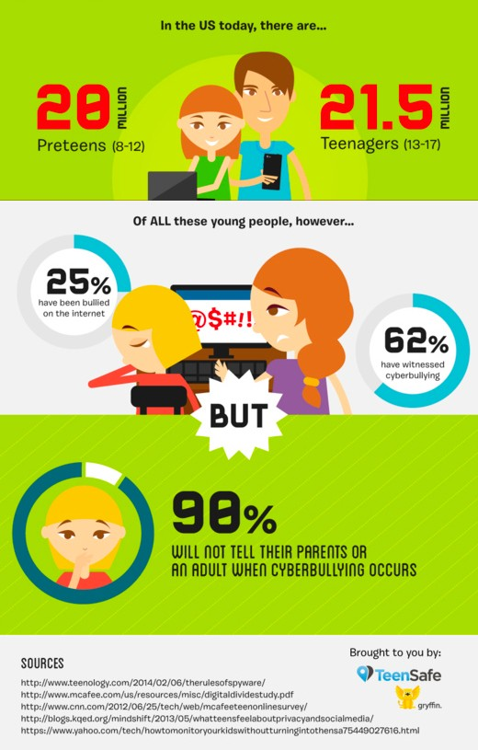
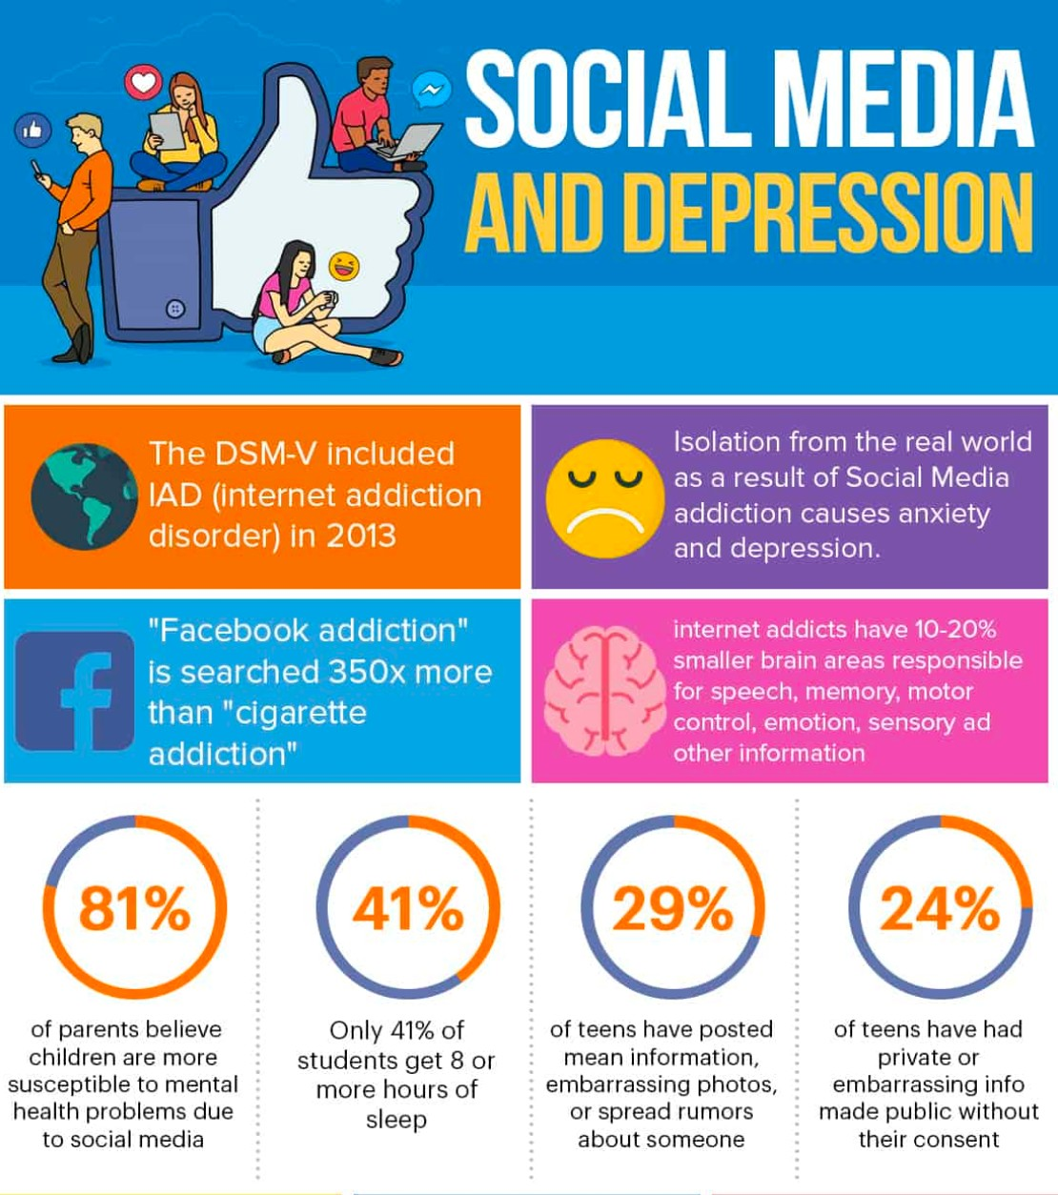
Motivation
Surveys
4

Slide 7







Motivation
Preventive Measures
5

Slide 8
Literature Survey
6
Title | Year & publication | Method | Data set | Result
Convolutional neural networks for toxic comment classification | 10th hellenic conference on artificial intelligence. 2018. | CNN for classifying into toxic and non toxic category | Wikipedia talk page | 91.2 %
Machine learning methods for toxic comment classification: a systematic review | Acta Universitatis Sapientiae, Informatica, vol.12, no.2, 2020 | Study of various machine learning and deep learning model | Twitter Dataset
A Supervised Multi-class Multi-label Word Embeddings Approach for Toxic Comment Classification. | International conference on knowledge and information retrieval, 2019 | Study of various machine learning and deep learning model | Wikipedia talk page | 92 %
DistilBERT, a distilled version of BERT: smaller, faster, cheaper and lighter | arXiv, 2019 | Distilled version of BERT | Wikipedia talk page | 40% fewer parameters than BERT and is 60% faster than BERT.

Slide 9
Outcome of literature survey
7
CNN is used for binary classification into toxic and non toxic comments is performing good and it is computationally less expensive.
Different technique for text embedding.
Text representation technique that capture the meaning of words in context of surrounding words in sentence.

Slide 10
Problem Statement
8
To train a comment toxicity detection model.
Create a Web API that can perform classification based on the saved trained model.

Slide 11
Methodology
9
Data Analysis
Data Preprocessing
Data Vectorization
LSTM, GRU, Logistic Regression model implementation
Model Evaluation
API implementation

Slide 12


Exploratory Data Analysis (EDA)
10
Toxic | Very Toxic |  | Hate
Obscene | Insult |  | Threat
16000
15294
12000
8449
7877
8000
4000
1595
1405
478
0
Sentiment
Training Data: Total: 159571 entries, Neutral: 124473 (none of the toxicity labels assigned)
Huge unbalanced dataset, no null entries and empty strings present
Multi-Label Classification Problem, target labels are not mutually exclusive, i.e. More than one right answer

Slide 13

Data Preprocessing
11
Lower Case All Words
Removed Punctuations
lower, camel or upper case written words treated as a same word
all, All, ALL converted to all
. , ; : etc.
Do not add any helpful information
Text Processing
Contraction Mapping
Removed Emojis
Removed emoticons, symbols, flags etc.
Could be helpful for certain cases of sentiment analysis
Contracted words are expanded
Example : aren’t : are not, can’t: cannot etc.
Fixed Misspelled Words
Removed Stopwords
the, in, among, for, where etc.
Do not add any helpful information
Corrected with TextBlob library
Lemmatisation
Finds the base form of words (spacy)
Debatable in Sentiment Analysis as it can reaks parts-of-speech tagging and alters polarity of a word
Reduces the word corpus

Slide 14
Data Preprocessing
12
Embedding Vectors
Pre-trained word embedding vectors Glove.6B is used
Tokenizer
Tokenizer (from keras) is used to tokenize the text with max vocab size of 20000
Each word is assigned to the corresponding feature vector from the Glove.6B

Slide 15
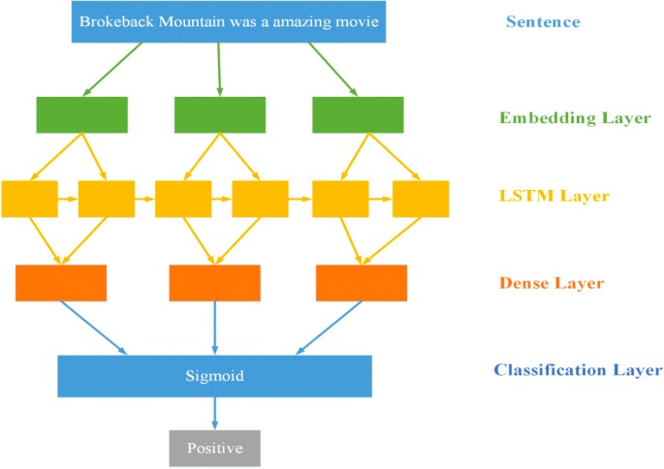
Deep Learning Model (Bi-directional LSTM)
Recurrent Neural Network (RNN) is used as it was primarily built to tackle NLP problems (sequential data, sentences are sequence of words)
13
I have used Bidirectional Long Short-Term Memory (LSTM) RNN model.
LSTM can remember longer sequences than regular RNN
Text
Making it bidirectional, helps in a way that it can see at a given sequence both previous and next sequences in the text/ sentence.
Embedding Layer
Bidirectional LSTM Layer
Global Max Pooling
Dense Layer
Sigmoid
Classification Layer
Target Classes

Slide 16
Experimental Setup
14
Language : PYTHON
IDE : Anaconda, PyCharm, Kaggle Notebook
Model Building : tensorflow, keras
Web API : GRADIO

Slide 17
Results
15

Slide 18
Logistic Regression Model Evaluation using 5-fold cross validation
16
The logistic Regression model is trained and evaluated for each class separately as logistic regression model can only perform binary classification. the average accuracy of each class is 98.59%.
Performance metrices for Logistic Regression with 5-fold cross validation
Metrics | Score
Area Under Curve ( AUC ) | 0.985991
F1 Score | 0.6701
Accuracy | 98.59 %

Slide 19
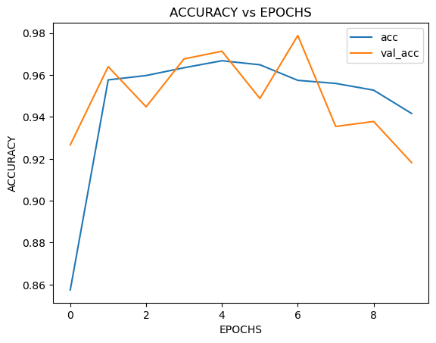
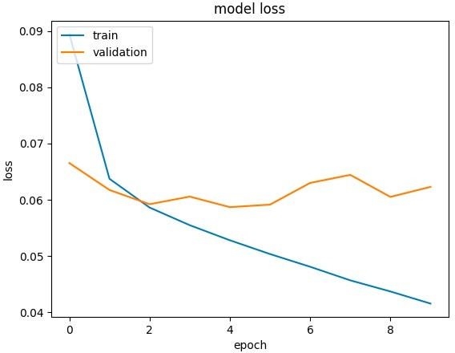
Bi-directional GRU Model Evaluation
20% of training dataset is kept for validation and rest used for training
Accuracies on both training and validation sets and loss in each epoch (used early stopping monitoring validation loss)
17
Metrics | Score
Validation Loss | 0.0497
Validation Accuracy | 91.82%

Slide 20
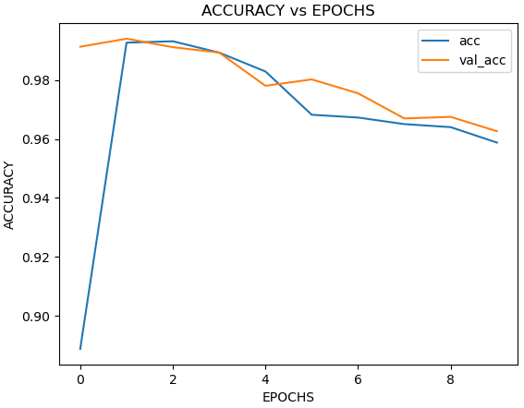
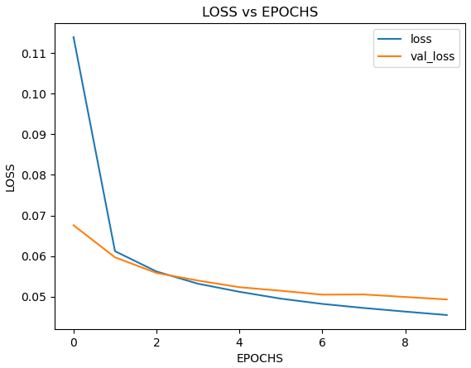
Bi-directional LSTM Model Evaluation
20% of training dataset is kept for validation and rest used for training
Accuracies on both training and validation sets and loss in each epoch (used early stopping monitoring validation loss)
18
Metrics | Score
Validation Loss | 0.0493
Validation Accuracy | 96.26%

Slide 21
DEMO
19

Slide 22
Conclusion & Future Work
Bi-directional LSTM model is the best performing model with 96 % Accuracy.
API is correctly classifying the text into different level of toxicity.
Additionally, the followings are some suggested studies to be considered as future work in this area:
Create Comment Toxicity detection for Multilingual Text.
using Other DNN techniques (CNN)) because some recently published papers s have shown that CNN proves to have a very high performance for various NLP tasks.
Using other text embedding and performing Hyper parameter tuning to improve performance of machine learning model.
20

Slide 23
References
21
Georgakopoulos, Spiros V., et al. "Convolutional neural networks for toxic comment classification." Proceedings of the 10th hellenic conference on artificial intelligence. 2018.
Andročec, Darko. "Machine learning methods for toxic comment classification: a systematic review" Acta Universitatis Sapientiae, Informatica, vol.12, no.2, 2020, pp.205-216. https://doi.org/10.2478/ausi-2020-0012.
Carta, Salvatore, et al. "A Supervised Multi-class Multi-label Word Embeddings Approach for Toxic Comment Classification." KDIR. 2019.
Sanh, Victor, et al. "DistilBERT, a distilled version of BERT: smaller, faster, cheaper and lighter." arXiv preprint arXiv:1910.01108 (2019).

Slide 24
Thank You

